Slide 1
Celebrating ODPs

Slide 2
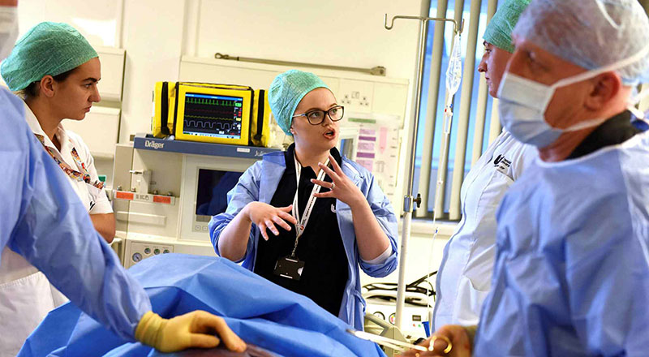
Thank you for all you have done... and for all you are doing
Thank you for all
you have done
and are doing

Slide 3
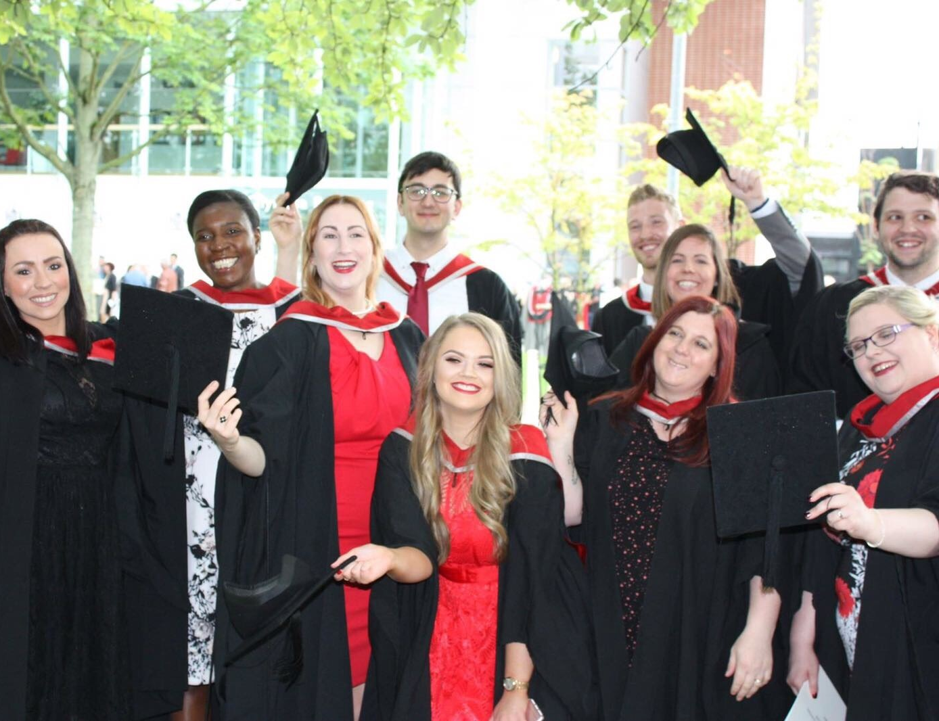
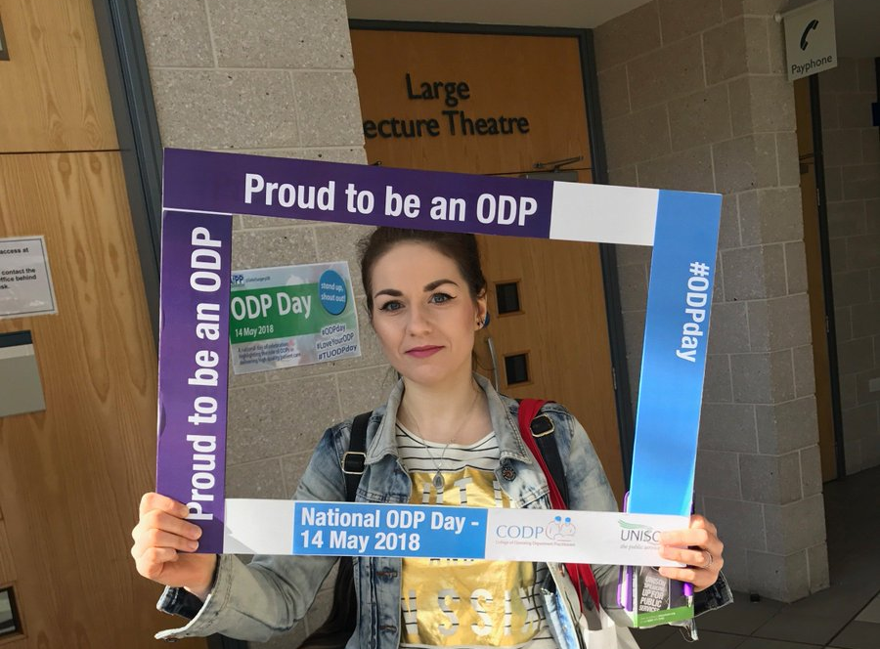
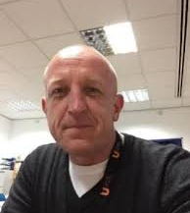
Proud of the ODPs we’ve trained
Proud to continue training

Slide 4
Celebrate
National ODP day
Join us at 8pm on Thursday 14th May along with our ODPs and theatre teams by clapping to say thank you.

